Slide 1
Becoming Bilingual: An Adventure in Implementation

Slide 2
Turn and Talk
Turn to the person sitting next to you.
What is your name?
Where are you from?
At what stage are you in your Dual Language Instruction journey?
Why did you come to this session?
Meet your fellow passengers!
Notes:
Cut out activity with ziploc bag - ARC Levels

Slide 3
Let’s meet the crew!

Slide 4
Monique Jacob - Quick Intro

Slide 5
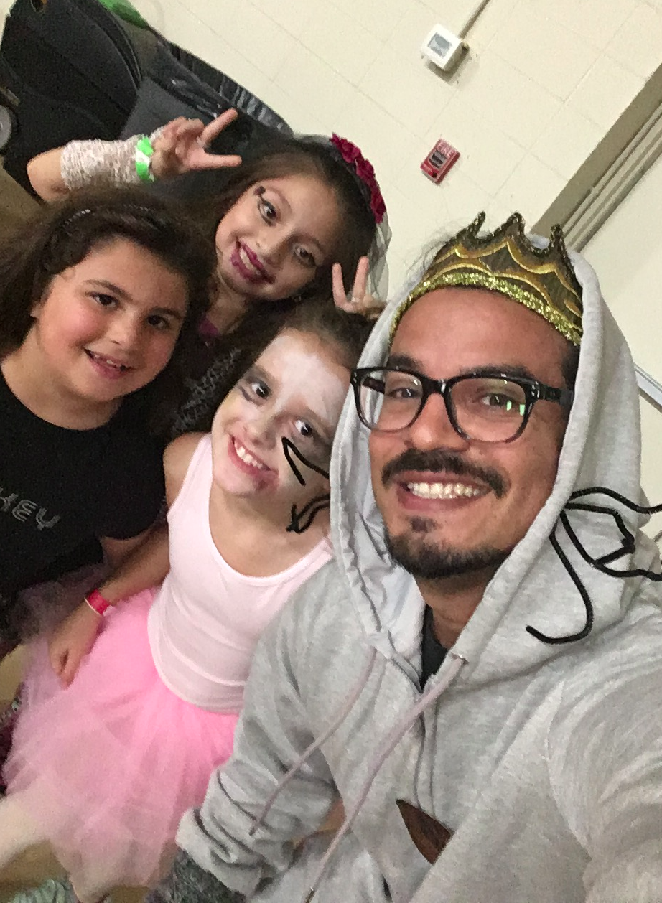
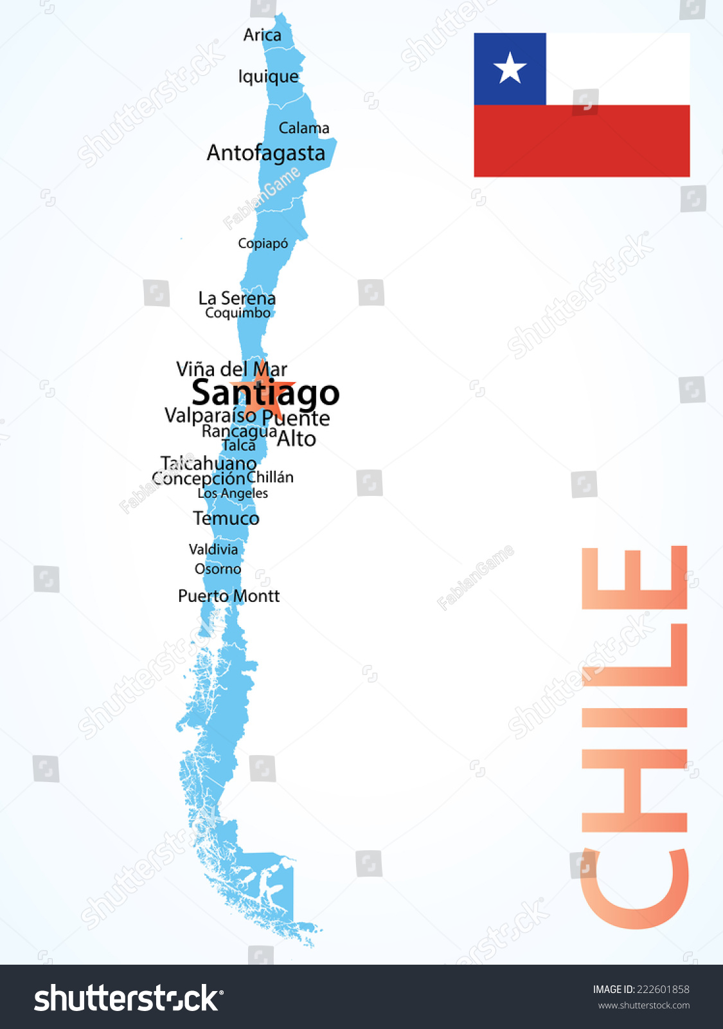
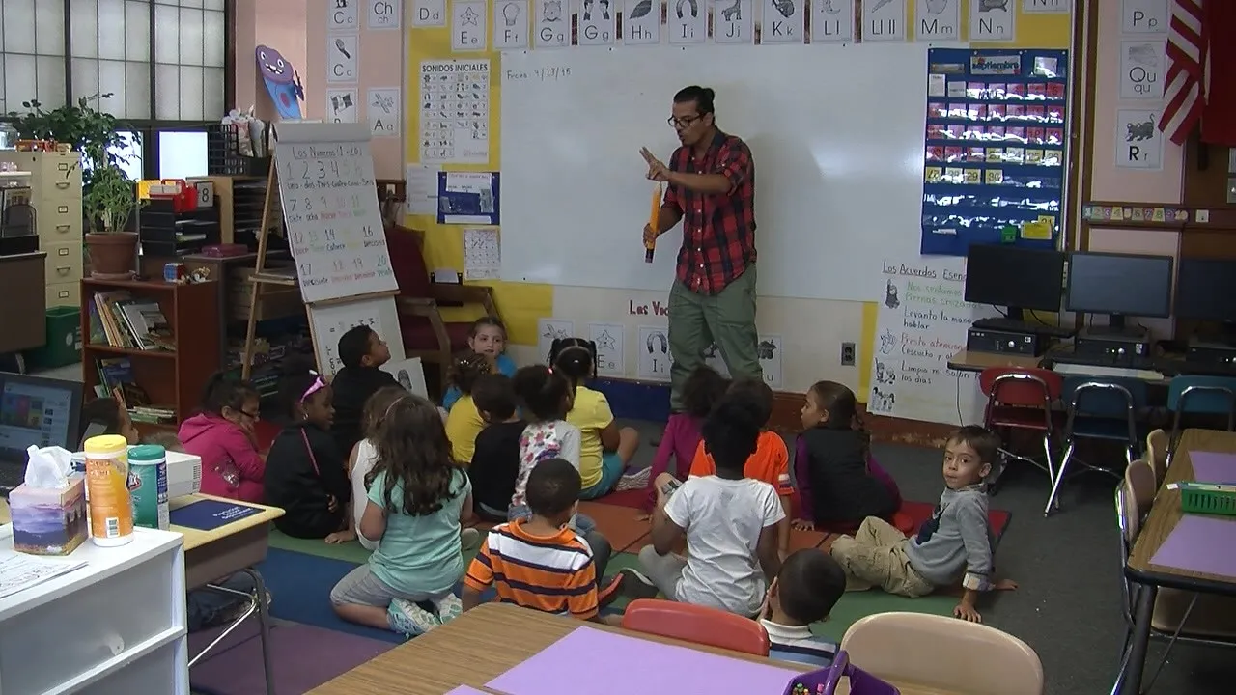
Pedro Silva Molina
Notes:
Pedro - What’s my why? I grew up in Chile, and I would be lying if I said I was your model student. I was a little energetic, more interested in the outdoors, and easily distracted. And in a military elementary school, these traits were not viewed favorably. In Santiago, I got a degree in Interpretation, and loved learning new languages and interacting with people from diverse cultures. When I moved to the United States, I got my first job here as a TA in a Dual Language K room in an urban elementary school in Washington, DC. I also began taking classes at UDC, in pursuit of a degree in psychology. I quickly realized a passion for teaching. After graduation, I was accepted to the Master of Teaching program and Brown Univiersity. During this program, I worked at three nearby elementary schools, and preferred working in the dual language programs.

Slide 6
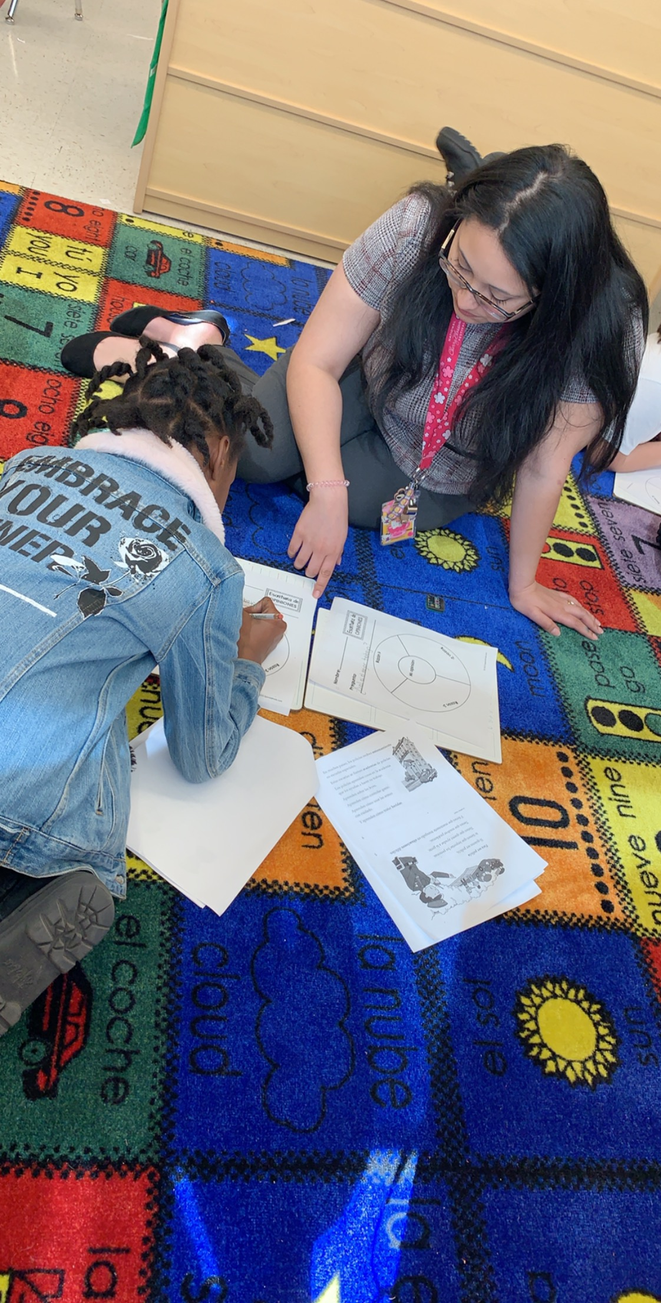
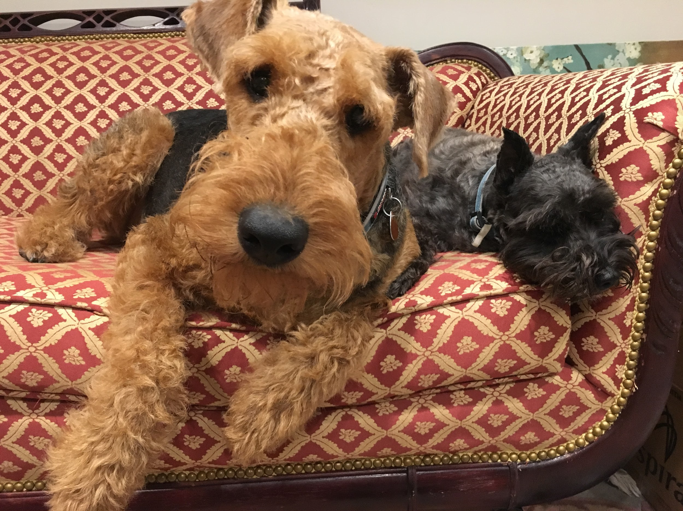
Katherine Alvarez-Huynh
Notes:
Katherine

Slide 7
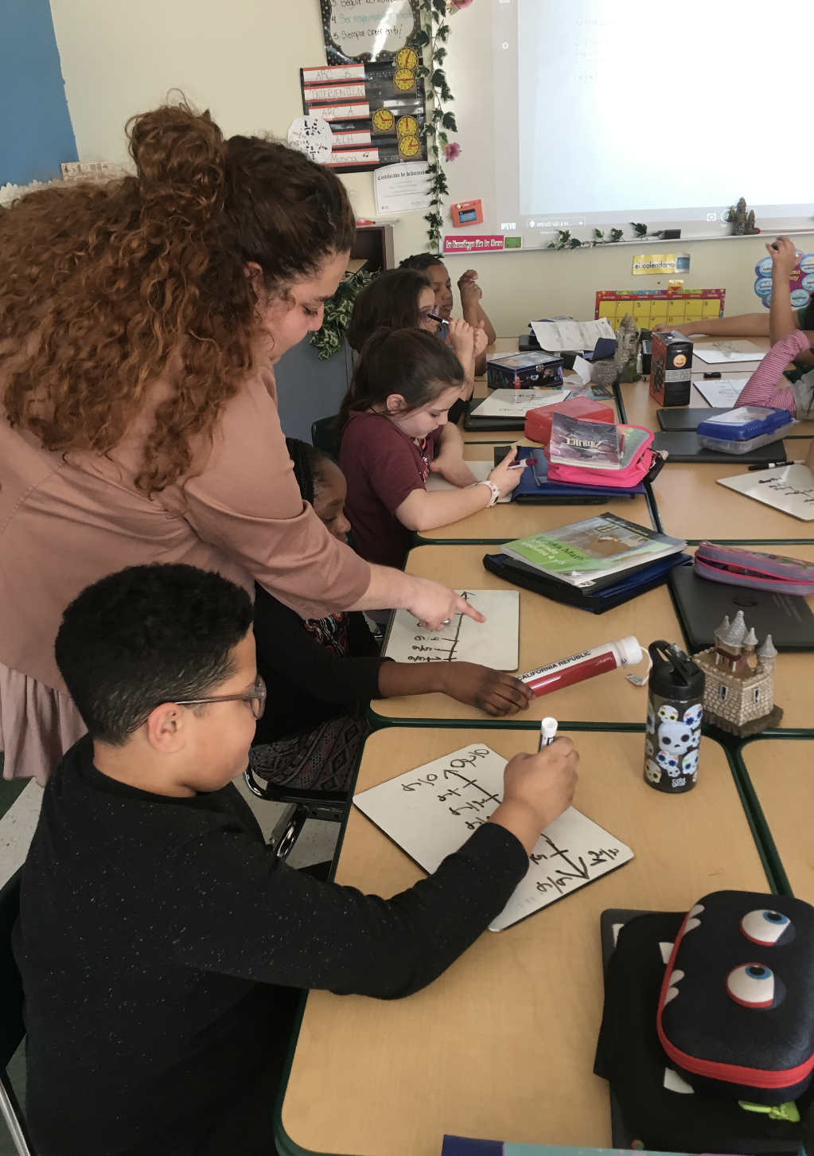
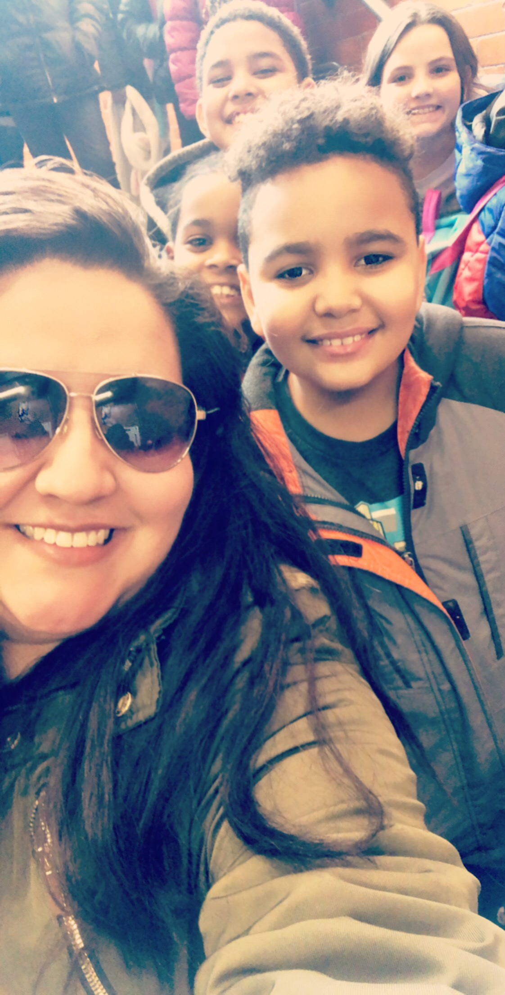
Michelle Carvajal

Slide 8
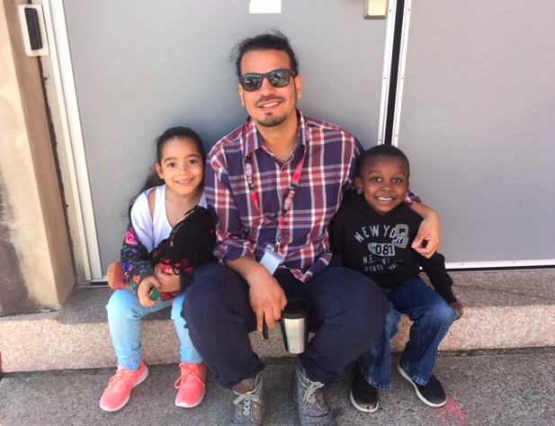
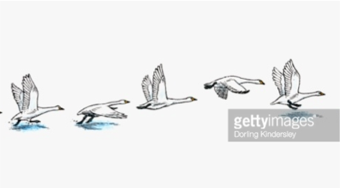
Preparing to Fly
RI Foundation provided grants to districts starting dual language programs ... Pawtucket jumped in
Superintendent had strong conviction that this was best for students … she has a cultural asset mindset
No overarching master plan, no slow rollout, lack of cohesive curriculum
Maintained one K monolingual classroom, started one K English classroom and hired me as the Spanish teacher
Notes:
Pedro

Slide 9
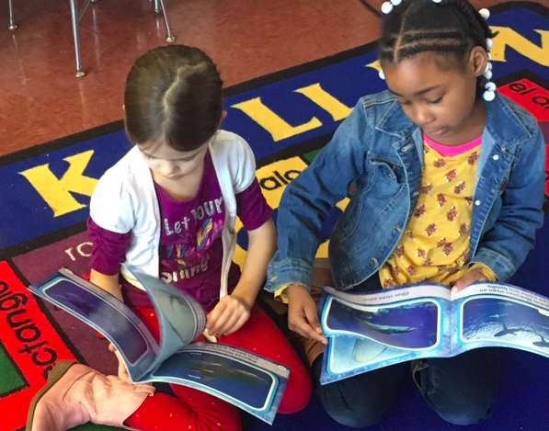
All Hands on Deck: The Journey Begins!
District and RIF provided grants for graduate coursework in DLI and TESOL
Initially, we made big news
Pawtucket’s inaugural program
Only school in district
Lots of collaboration and creating of activities
Curriculum director
Purchase of books and supplies
Magic Tree House in Spanish and English
Budgeting and teamwork is crucial!
Very grassroots, built by the teachers, but had high support from district and local administration
Notes:
Pedro

Slide 10
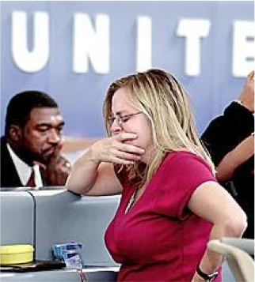
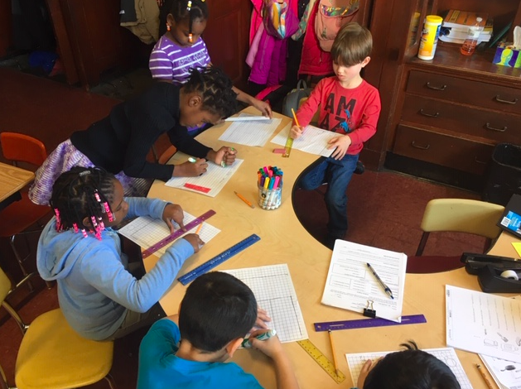
Year one: Are they buying what we’re selling?
Students seemed to love learning Spanish - enjoyed the challenge
Anecdotally (we did not have solid data metrics at the time), but students were progressing quickly
Parents, community members, and other colleagues still needed convincing.
E.g. Ania’s Mother
Communication is crucial:
Newsletters to parents
Participation in family activities
Engagement with the community
Cohort members are important
All DL team members were fully invested
Other colleagues were curious or hesitant, but we tried to demonstrate the value of the program.
Notes:
Pedro

Slide 11
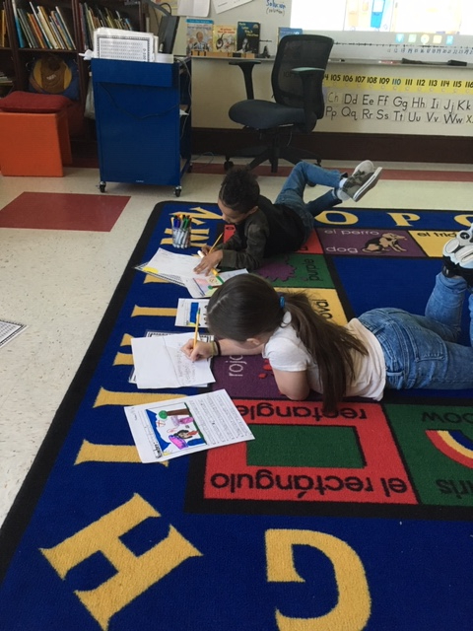
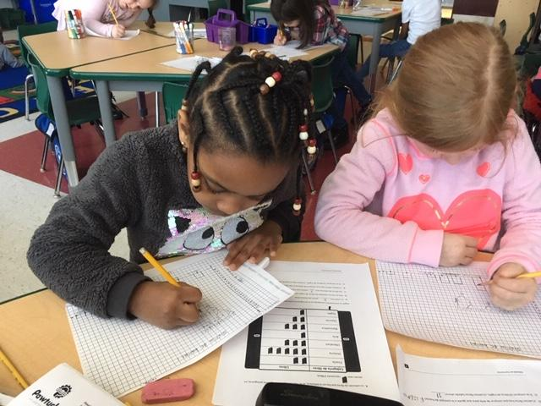
Year two: touching the sky
Rolled into year 2, I looped with students into 1st grade, and we hired another K Spanish teacher
Kindergarten English teacher moved to 1st grade and joined the dual language.
Our cohort was now a solid group of four
Continued collaboration and initiatives from first year, refining and modifying as we went along.
Students were enthusiastic about learning another language.

Slide 12
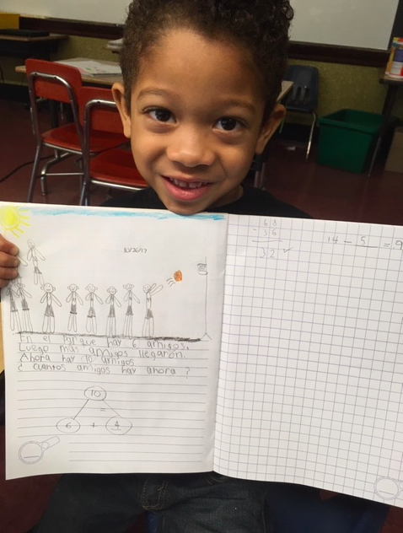
Turbulence ahead!
Challenges in the first two years included:
Imbalance in English-native students and Spanish-native/heritage
Ideally 50-50, we were closer to 80-20
Class size increased
Classes went from 18 per class in year one to 23 per class in year two
Interest in program increased exponentially
Did not have the capacity to seat all students
Teacher displacements created nervousness among some faculty
Teacher recruitment
Hard to find qualified and willing staff
Teachers needed to take courses to progress toward certification
Notes:
Pedro

Slide 13
Year three: Getting on board
In 2016 the district purchased the ARC curriculum for the DL program. The program provided a cohesive curriculum where the teacher guide in Spanish mirrored English.
This curriculum incorporates reading and writing as well as some science and social studies.
There was a suggested schedule for the program but we learned quickly that it had to be adjusted for the 50/50 DL model at our school.
Notes:
Katherine
ARC new program before no program -Mirroring the english side, Info on ARC. talk about how we schedule the times to incorporate the ARC program.
No dl report card to a spanish ACTFL proficiency to New report cards that mirrors english.
Make copies of the ACTFL card and the new report card.

Slide 14
Embarking upon the ARC
We had concrete plans and guidance for each grade level
We now had reliable reading level testing with the ENIL and toolkits for intervention.
We can see accurate proficiency levels with the data.
We had a way to monitor and track student growth in both languages.
Notes:
Katherine talk about how we schedule the times to incorporate the ARC program.
Many ways to make it work!!
50/50 model - there are different models
Less transitions as possible would be best.
Minutes have to be changed to accommodate the dl program.

Slide 15
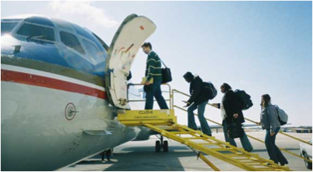
Reporting out considerations
There was no grading system for Spanish.
In 2016, DL teachers decided that something had to be done to inform parents of their students’ progress in Spanish.
The Student Proficiency report was adapted from the one used in Utah.
In 2018, the district created a report card that mirrored the English version
Notes:
dl report card to a spanish ACTFL proficiency to New report cards that mirrors english.
Make copies of the ACTFL card and the new report card.

Slide 16
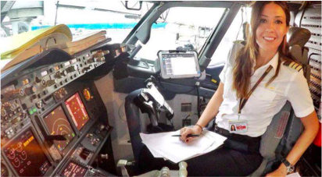
Year four: Feeling the power
Curriculum is often modified for grade level
Modules are 3-5 with materials at end of fourth grade into fifth grade level
Supplemental resources to meet student needs and understanding.
Home-school connection is lacking
Pull-out services (IEP, ELLs)
RICAS
Notes:
Michelle-
STAR Spanish/ ARC levels - All started at same level with same skills, this is the difference

Slide 17
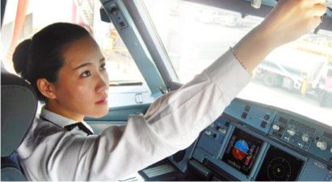
Building capacity in others
Diversification of faculty
Value of program
Professional development
Dual language teacher certification requirements
Notes:
Michelle-
Diversification of staff- As the program grows, we have an increase of bilingual staff members. Its starting to reflect the population that we have
Value of program- In order to open our DL program, there was a displacement of one monolingual classroom. Faculty believes in the value of bilingual education, fear of job security.
PD- ARC provided professional development training as grade levels expanded along with in-school pd when the program started 2016-2017 for both English and Spanish but has not been continuous
DL certification- Faculty was displaced due to lack of certification in DL. Certificate route or Masters

Slide 18
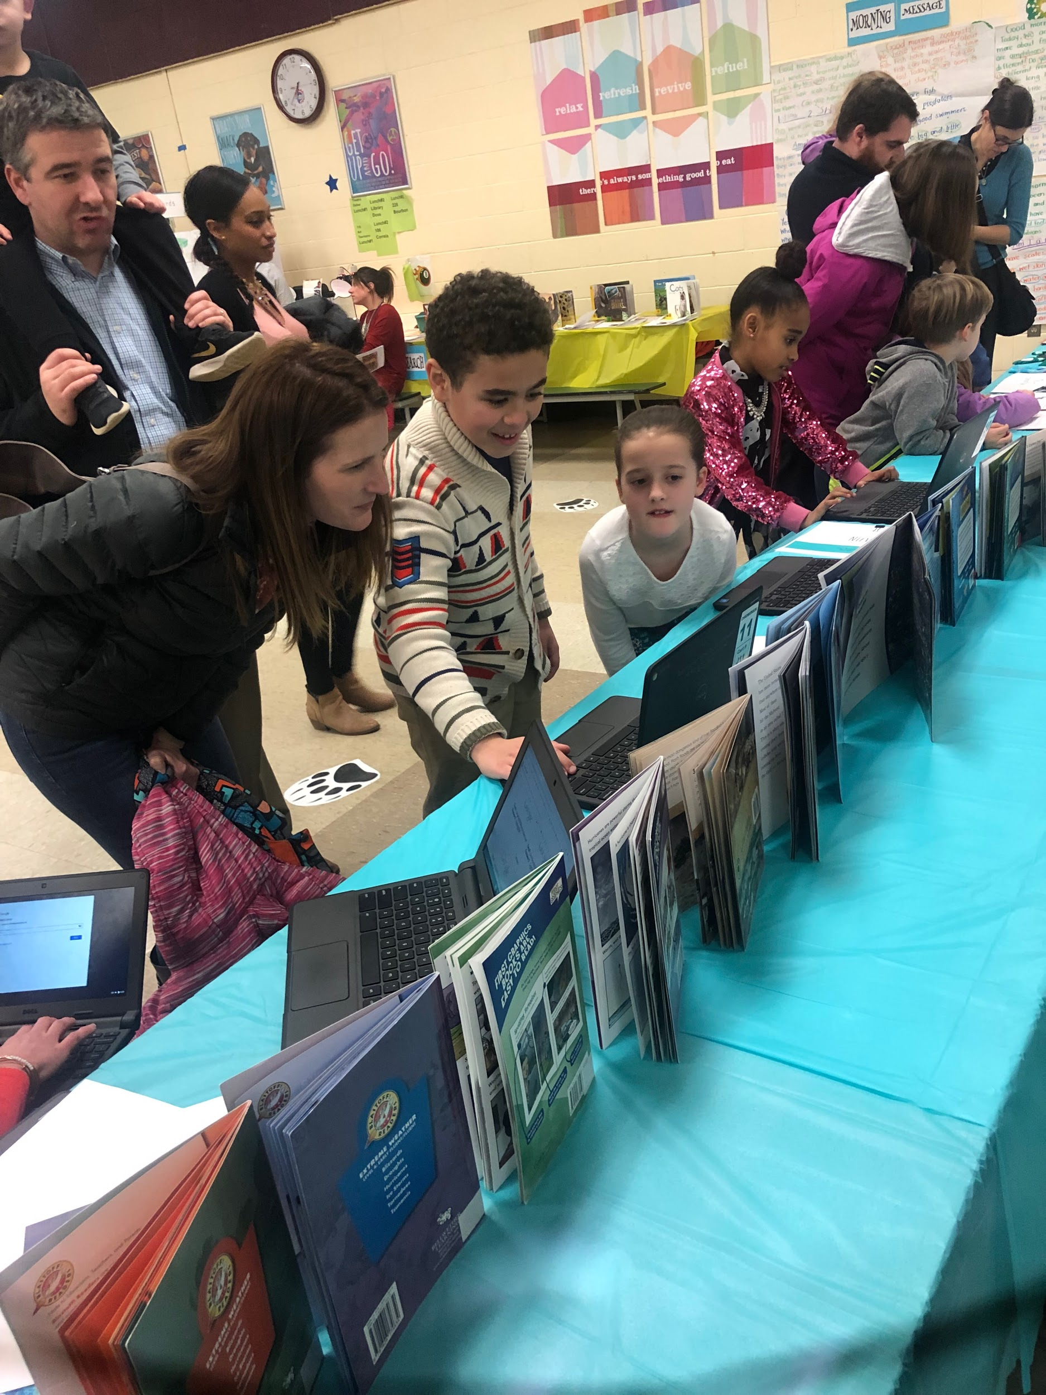
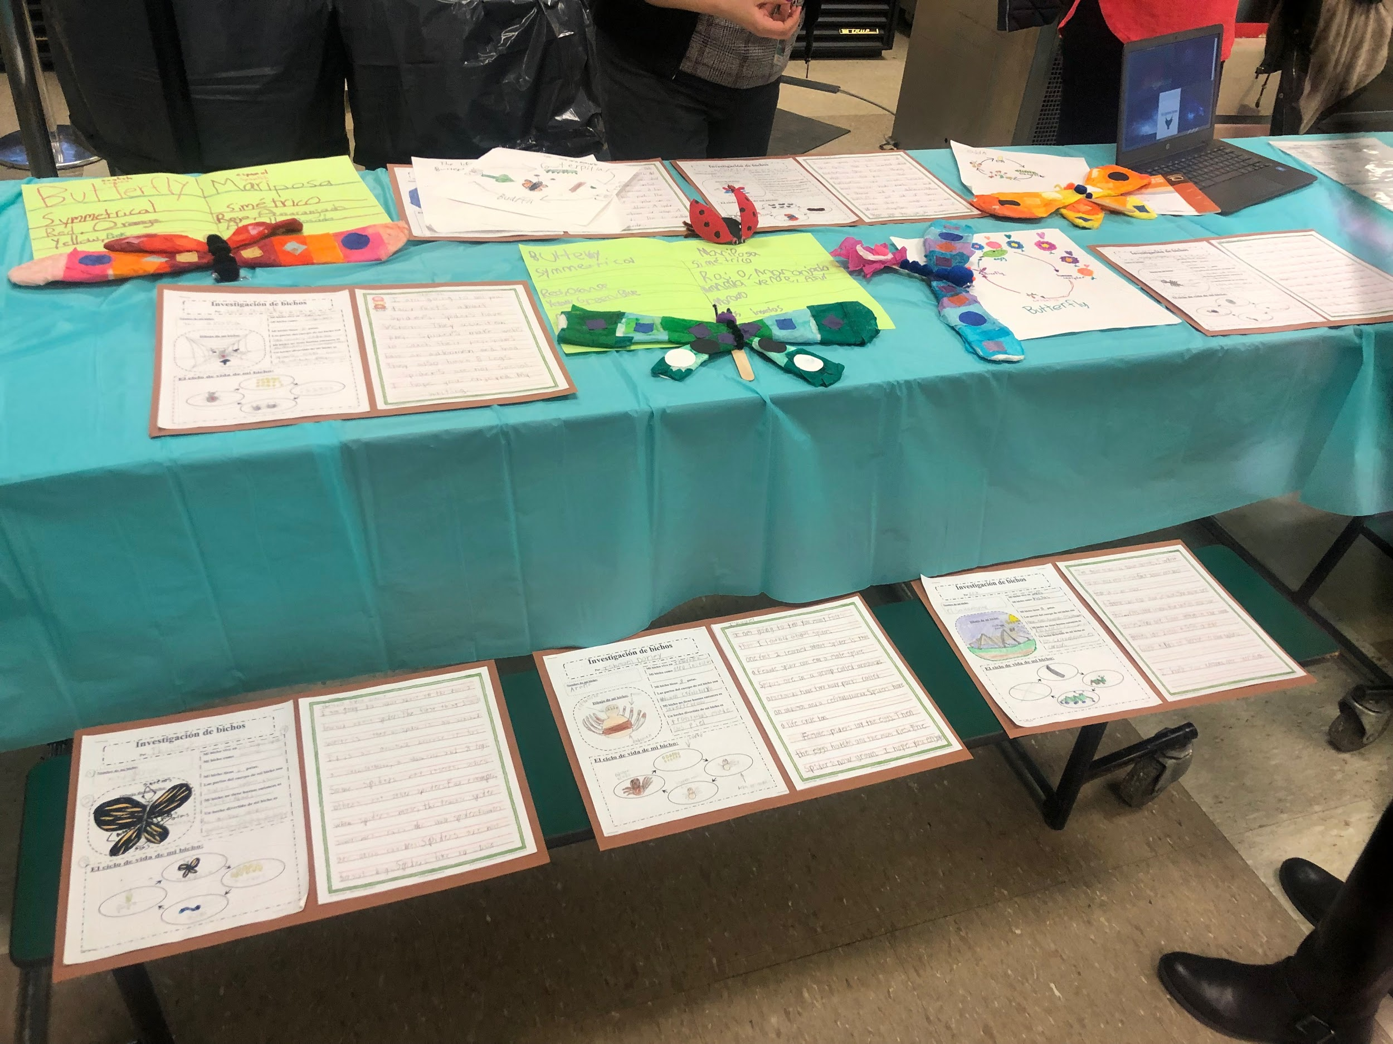
Building our community
Town Hall meetings
Parent engagement nights
->Speaking in tongues
Curriculum night
Multicultural night
Notes:
Michelle -
Town hall meeting- Students in each grade level present on a monthly basis to show other grade levels what they are learning within their curriculum
Parent engagement nights- Held to inform parents on what is happening with the curriculum and to answer questions and concerns
Curriculum night- District-wide
Multicultural night- PTO
Multilingual advocacy day- Promoting and bringing awareness to multilingual education in the state and to support the World languages and dual language Act in RI

Slide 19
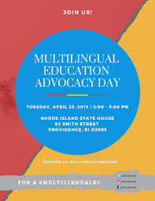
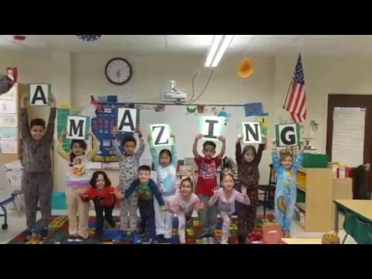
Multicultural Advocacy Day

Slide 20
Enjoying the view
What we have learned in our 4 years of implementation:
Full school community buy-in and positive energy is crucial
Spend money on a cohesive curriculum and teacher recruitment
Allow for time for the cohort to meet, plan, and learn together
Involve everyone in discussion about language acquisition theory and practical aspects of learning a foreign language
Notes:
Monique - Maybe talk about building the master schedule?

Slide 21
Route to our final destination
Continue to roll up DL classrooms (next year, grade 4!)
Advocate for common literacy program (ARC) for DL AND mono language classes
Beyond reading, writing and mathematics to i increased oral proficiency
Increasing balance of Spanish and English speakers (Enrollment policy)
Planning for beyond Nathanael Greene - middle and high school
Notes:
Monique-

Slide 22
Help us land!
What do districts need to keep in mind when developing and implementing dual immersion programs? And what helps sustain these programs?
What strategies exist to help students who enter the Bilingual strand at a later grade catch up in their target language acquisition?
Should students who are making little to no progress in their second language leave the DL program?
HANG IN THERE!
Notes:
All

Slide 23
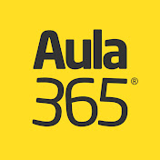
Last minute landing preparations
Happy Learning https://www.youtube.com/channel/UCGkVdu_EVrqqxQ7OnLFK8RQ
DoReMi https://www.youtube.com/channel/UCNTl__yGTRH7usCFazeXheQ
CNTV Infantil https://www.youtube.com/user/NovasurTV
Aula365 https://www.youtube.com/channel/UCE3m5uW9fUnf_tuKsVAmVPw
Basho & Friends https://www.bashoandfriends.com/
Luna Creciente https://www.youtube.com/user/lunacreciente

Slide 24
Thank you! ¡Gracias!

